Slide 1

Determination of Latitude and Longitude of Traffic Sign Using Stereo Camera Vision Algorithm
Abrar Islam

Slide 2
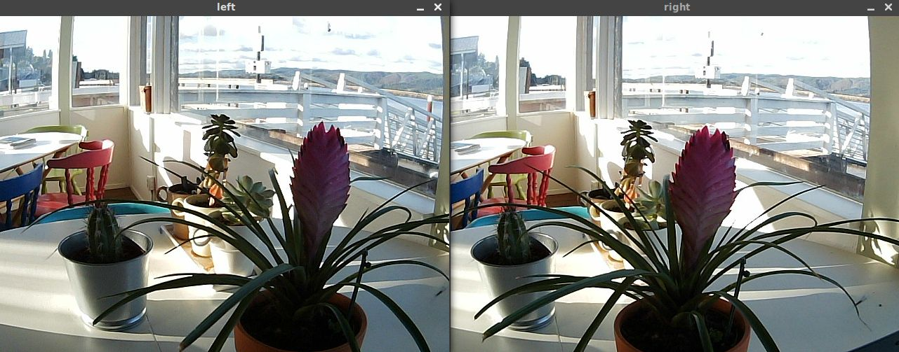
Introduction
Stereo Camera uses two images to determine the position of the object – left images and right images.
In our case, two sequential images can be considered as left and right images and then the algorithm of stereo camera can be applied.
Fig. Left and right images of a stereo camera

Slide 3
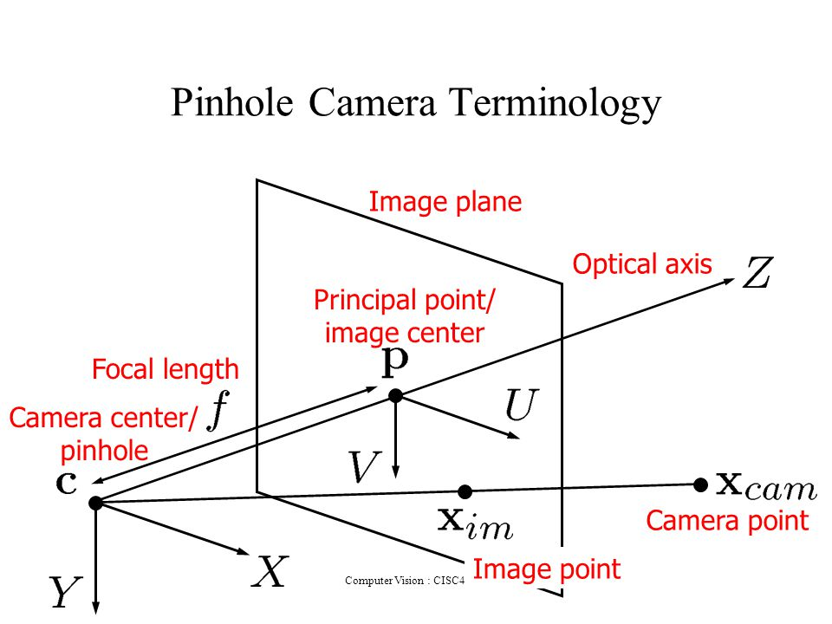
Necessary Parameters
The parameters that are needed to calculate position of an object –
Focal Length of the camera
in x direction – f_{x}
Focal Length of the camera
in y direction – f_{y}
Principal Point of the camera – P (o_{x ,} o_{y})
Fig. Focal length and Principle Point

Slide 4
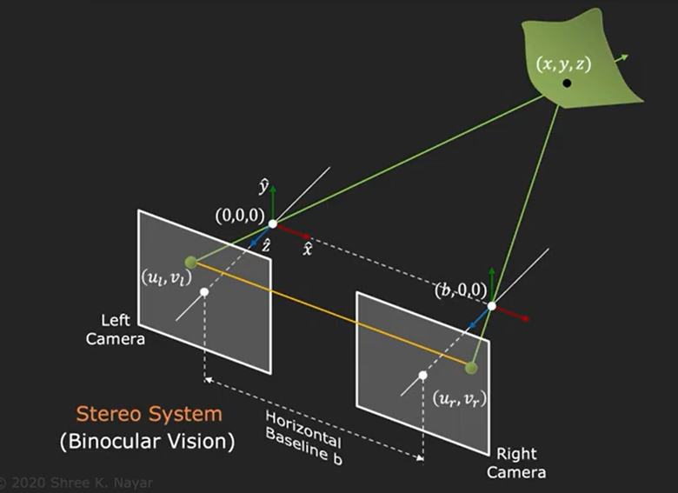
Motivation
Stereo Camera Algorithm –
Stereo Camera uses triangulation to determine the x, y, z co-ordinate of a object
Left camera position is considered as the origin.
Among the co-ordinate values, z is the depth.
(u_{l ,} v_{l}) and (u_{r ,} v_{r}) are the two points in the image where the particular object is located
Baseline (b) is the distance between two cameras.
Fig. Triangulation method of stereo camera

Slide 5
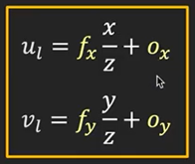
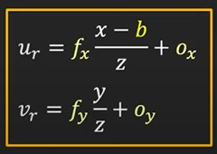
Motivation
The method follows some series of geometric calculation.
Obtain the following for equations.
With the help of them, the value of x, y, z are determined.
Equations from left images
Equations from right images

Slide 6
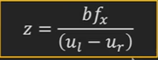
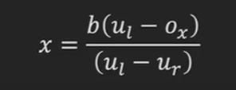
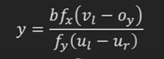
Motivation
To determine z (depth), value of f_{x} is needed.
To determine x, value of o_{x} is needed.
To determine y, values of f_{x} , f_{y} , o_{y} are needed.

Slide 7
Methodology
How to apply triangulation method to determine the location of the traffic sign
Steps
Go through images and select the images containing traffic sign.
Find the suitable pair image by comparing camera position (considered as left and right images).
Annotate the traffic sign in the both images.

Slide 8
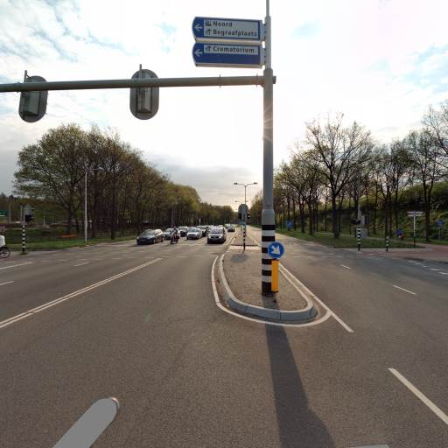
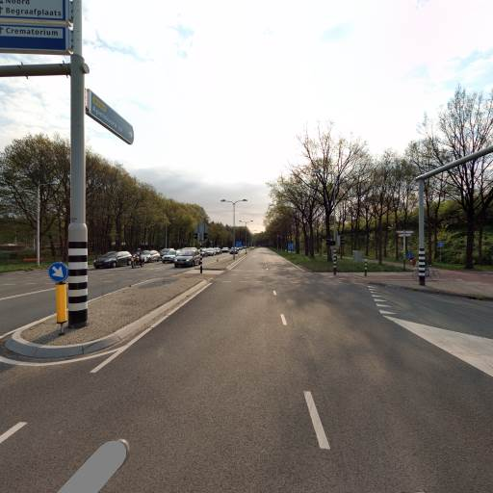
Methodology
Step 2
Example of two suitable pair of images which will be considered as left and right images.
Image 1
Image 2

Slide 9
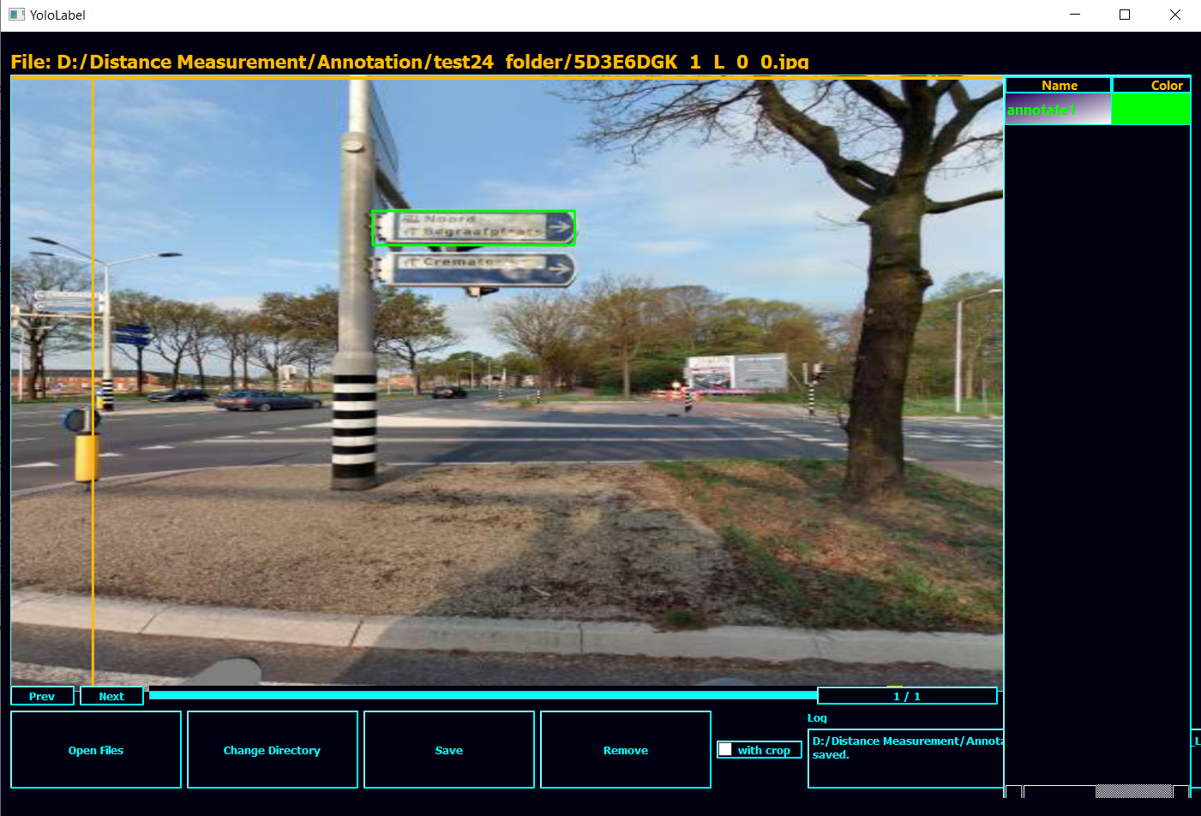
Methodology
Step 3
Object location in the images ( (u_{l ,} v_{l}) & (u_{r ,} v_{r}) ) needed to be known.
In our case, annotation is used to know these values.
Annotation gives the center value of the rectangular box (traffic sign).
Fig. Annotating the traffic sign

Slide 10
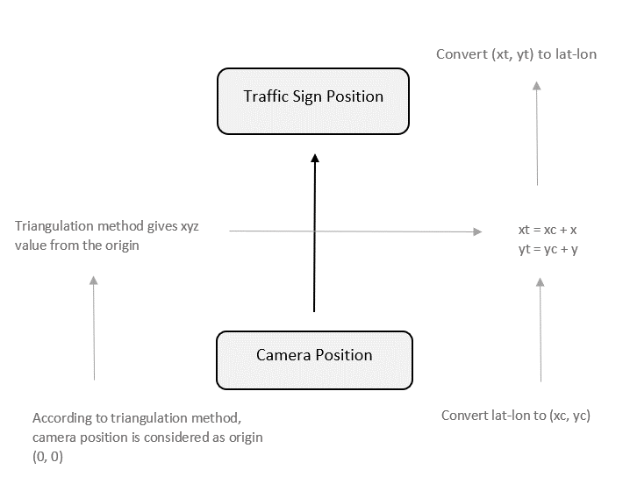
Methodology
Steps
The difference between the two camera position is calculated, which is considered as Baseline (b).
Using the triangulation method x, y, z co-ordinates of the traffic sign from the camera is calculated.
Convert the latitude and longitude of the camera position into cartesian x, y, z co-ordinates using following formulas.
xc = R * cos(lat) * cos(lon)
yc = R * cos(lat) * sin(lon)
zc = R *sin(lat)
Fig. Step 5-9 overview
*R is the radius of the earth

Slide 11
Methodology
Steps
Add the xyz values obtained from the triangulation method with the camera position.
The addition result will give the position of the traffic sign (xt, yt) in cartesian co-ordinate system.
xt = xc + x
yt = yc + y
Fig. Step 5-9 overview
*the value of z is not needed anymore, that’s why it was not calculated

Slide 12
Methodology
Steps
Using the reverse conversion formula, convert the xy co-ordinates of the traffic sign to latitude and longitude.
lon = tan⁻¹ (yt / xt)
lat = cos⁻¹ (xt / (R*cos(lon)))
Fig. Step 5-9 overview

Slide 13
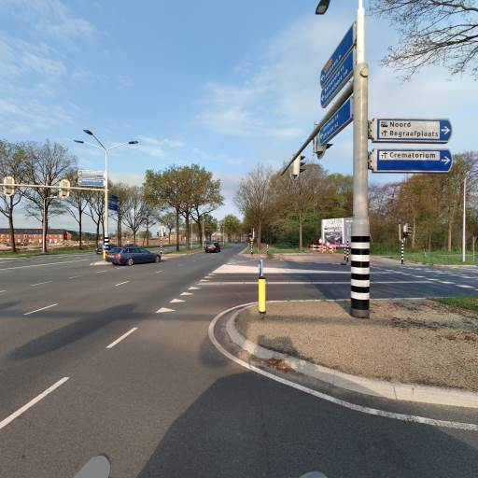
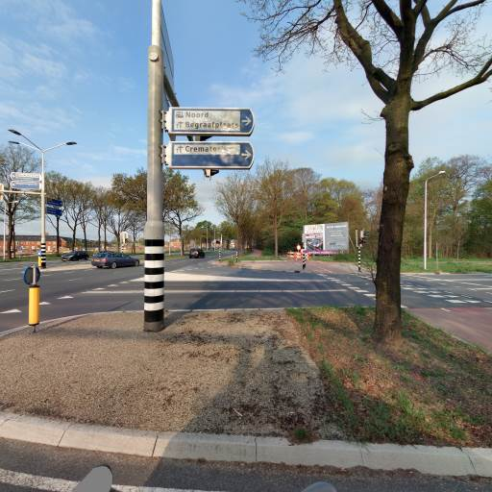
Example
Step 1 & Step 2
Select two pair of suitable images containing traffic sign

Slide 14
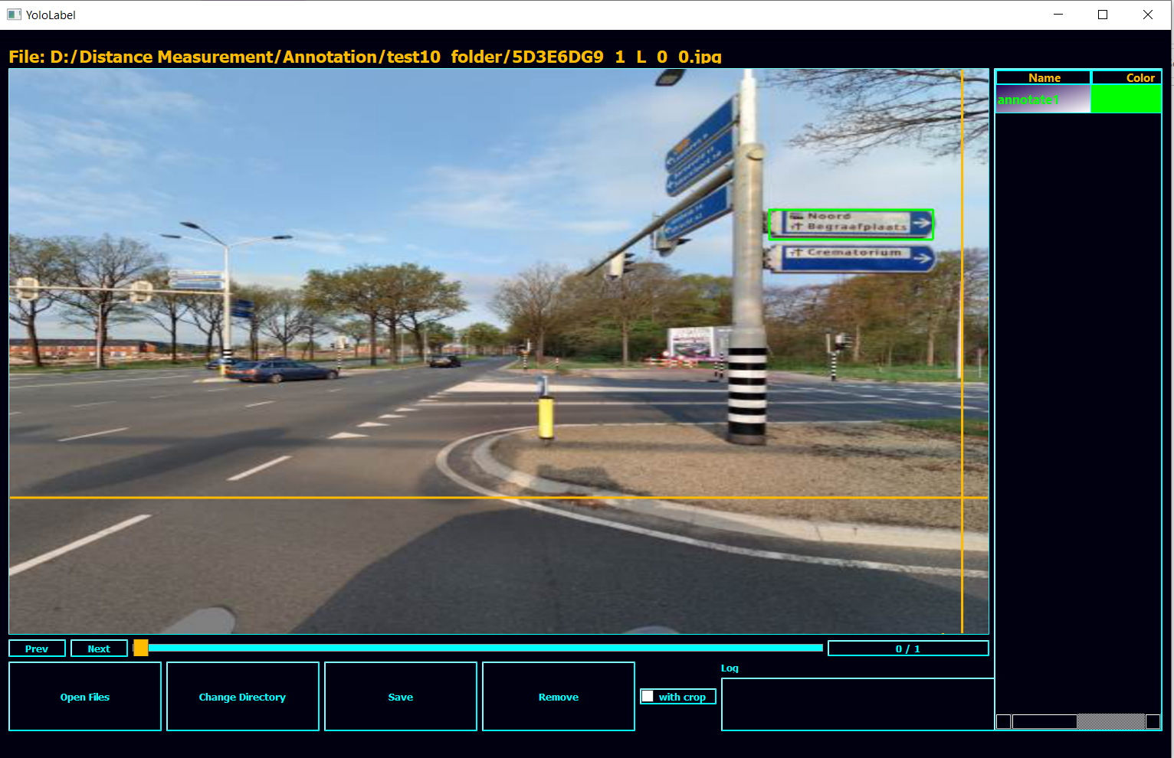
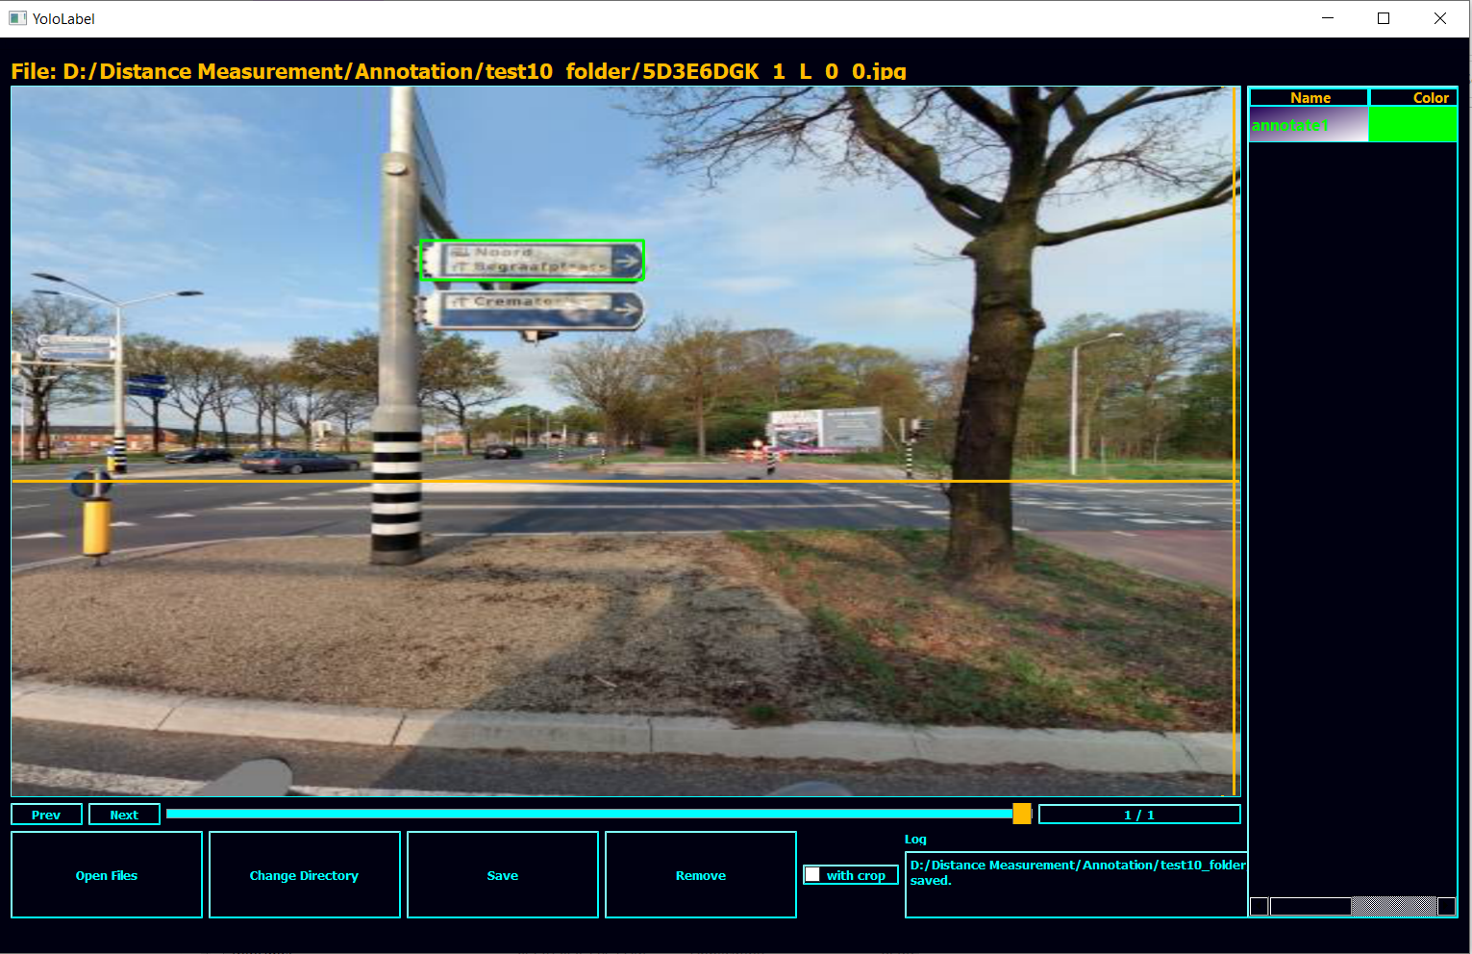
Example
Step 3 (Annotation)

Slide 15
Example
Step 4 (Determination of Baseline)
4.988 m
Step 5 (Calculating xy co-ordinates)
1.5239, -0.5974
Step 6 (Converting Lat-Lon of camera position)
3898873.5949, 385708.0217, 5023908.3404
Step 7 & 8(Adding values)
3898875.1188, 385707.4244

Slide 16
Example
Step 9 (Back conversion to Lat-Lon)
52.05101903560742 5.649766579242047
Actual position : 52.05101765 5.64983258
Error : 4.5157 m

Slide 17
Challenges
The values of camera intrinsic parameters (f_{x} , f_{y} , o_{x} , o_{y} ) are need to be known.
Only the default value of f_{x} is given.
f_{y} , o_{x} , o_{y} values are unknown.
Using back calculation and ground-truth value, trying to find the appropriate values.
Too much deviation in the predicted value.

Slide 18
Thank you

